Slide 1

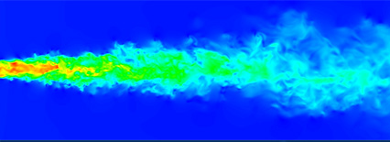
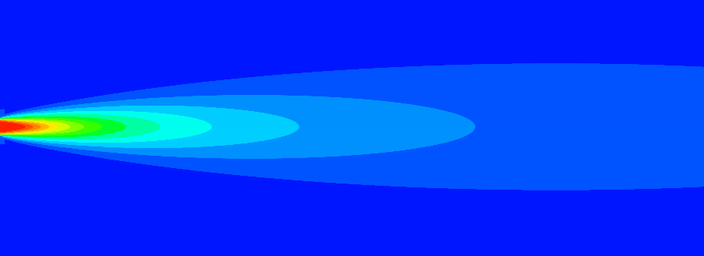
2D RANS Simulation of an Axisymmetric Turbulent Round Jet
Image adapted from: M. Oberlack, 2022 [1]
Tom BEAUVE
Guillaume VAILLOT
AERO0004 : Turbulent Flows
2025 - 2026
1

Slide 2

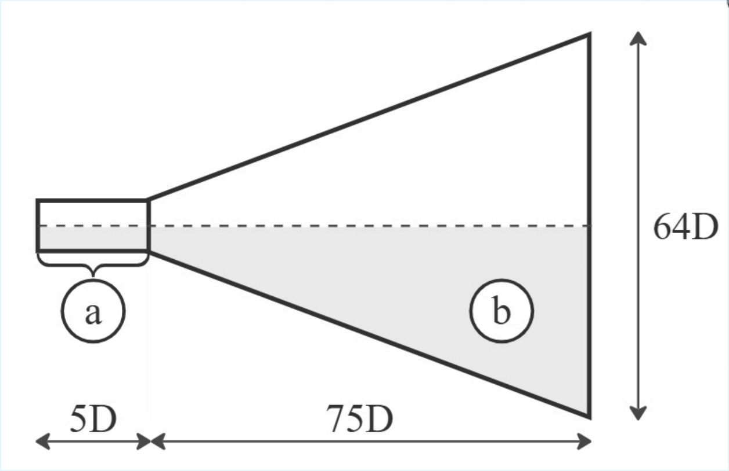
Problem description & geometry
3D DNS Reference setup
Re = 3500
D = 0.2 m
a) Turbulent tube inlet
b) Study domain
Latteral inlet
Velocity
Inlet
Pressure
Outlet
2

Slide 3
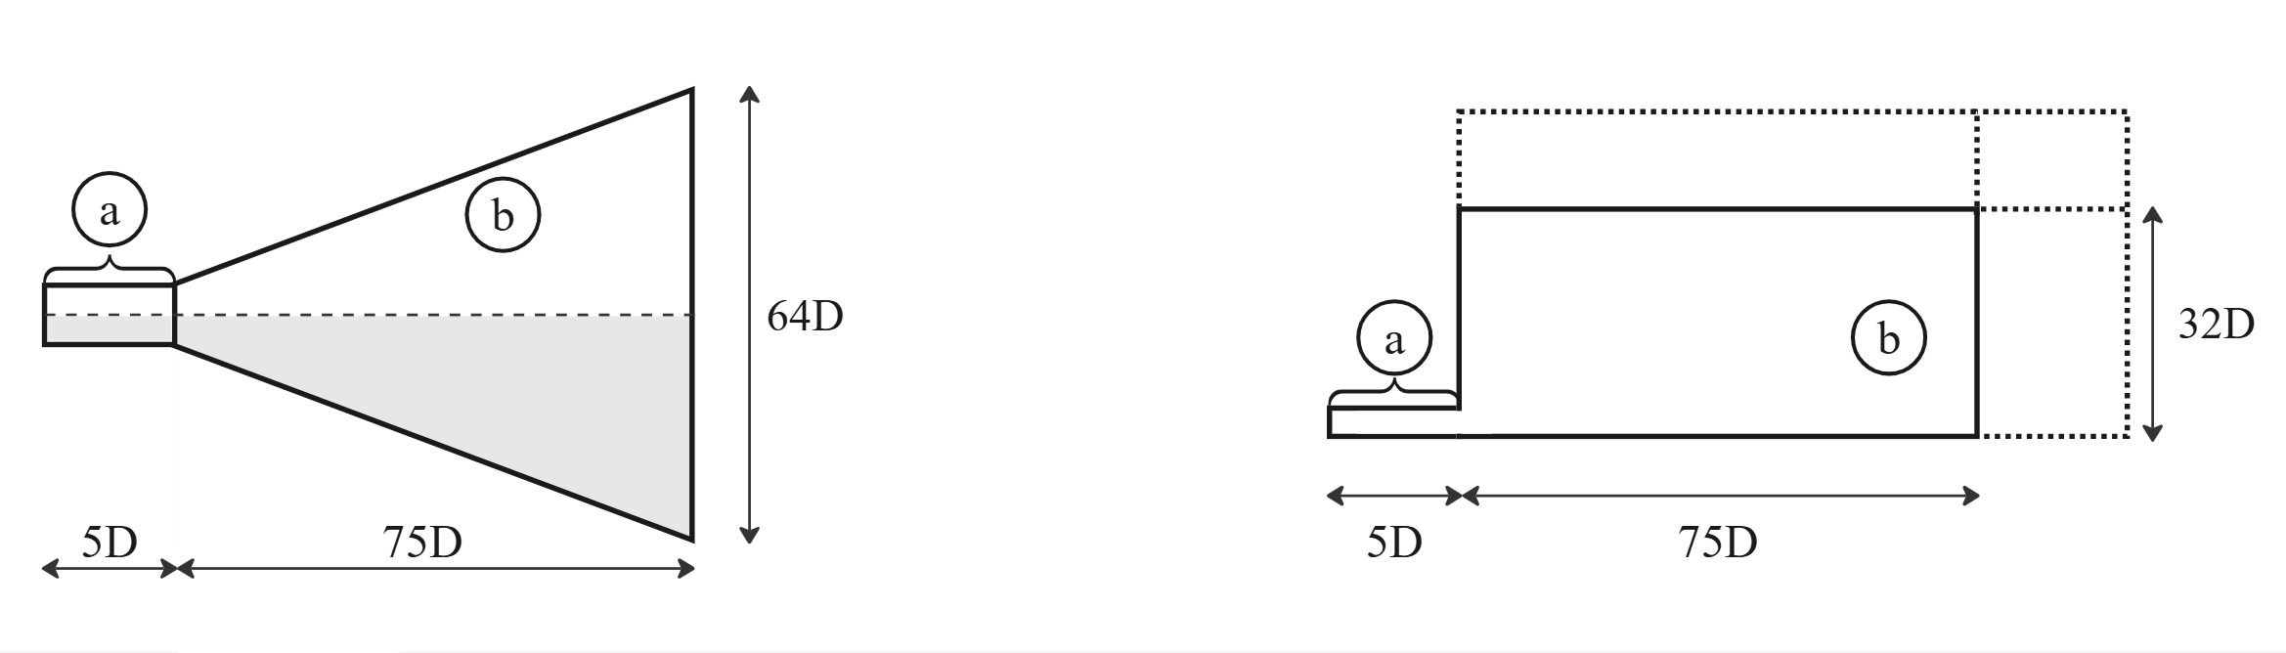
CFD modelling strategy
2D RANS CFD Model
Domain and boundary readapted
Multibloc structured mesh with quadrilateral elements
Critical backflow
Neumann p
Ansys Fluent
implementation
Symetry
Dirichlet elliptic U
Dirichlet p
3

Slide 4

Convergence / Verification process
k-ϵ and k-ω RANS models
1 - Residuals Convergence
${10}^{−6}$ Tolerance
2 - Domain size
convergence
2.25 Scalling
3 - Grid size convergence
≈ 99k cells
4 - Boundary turbulence sensitivity
4

Slide 5
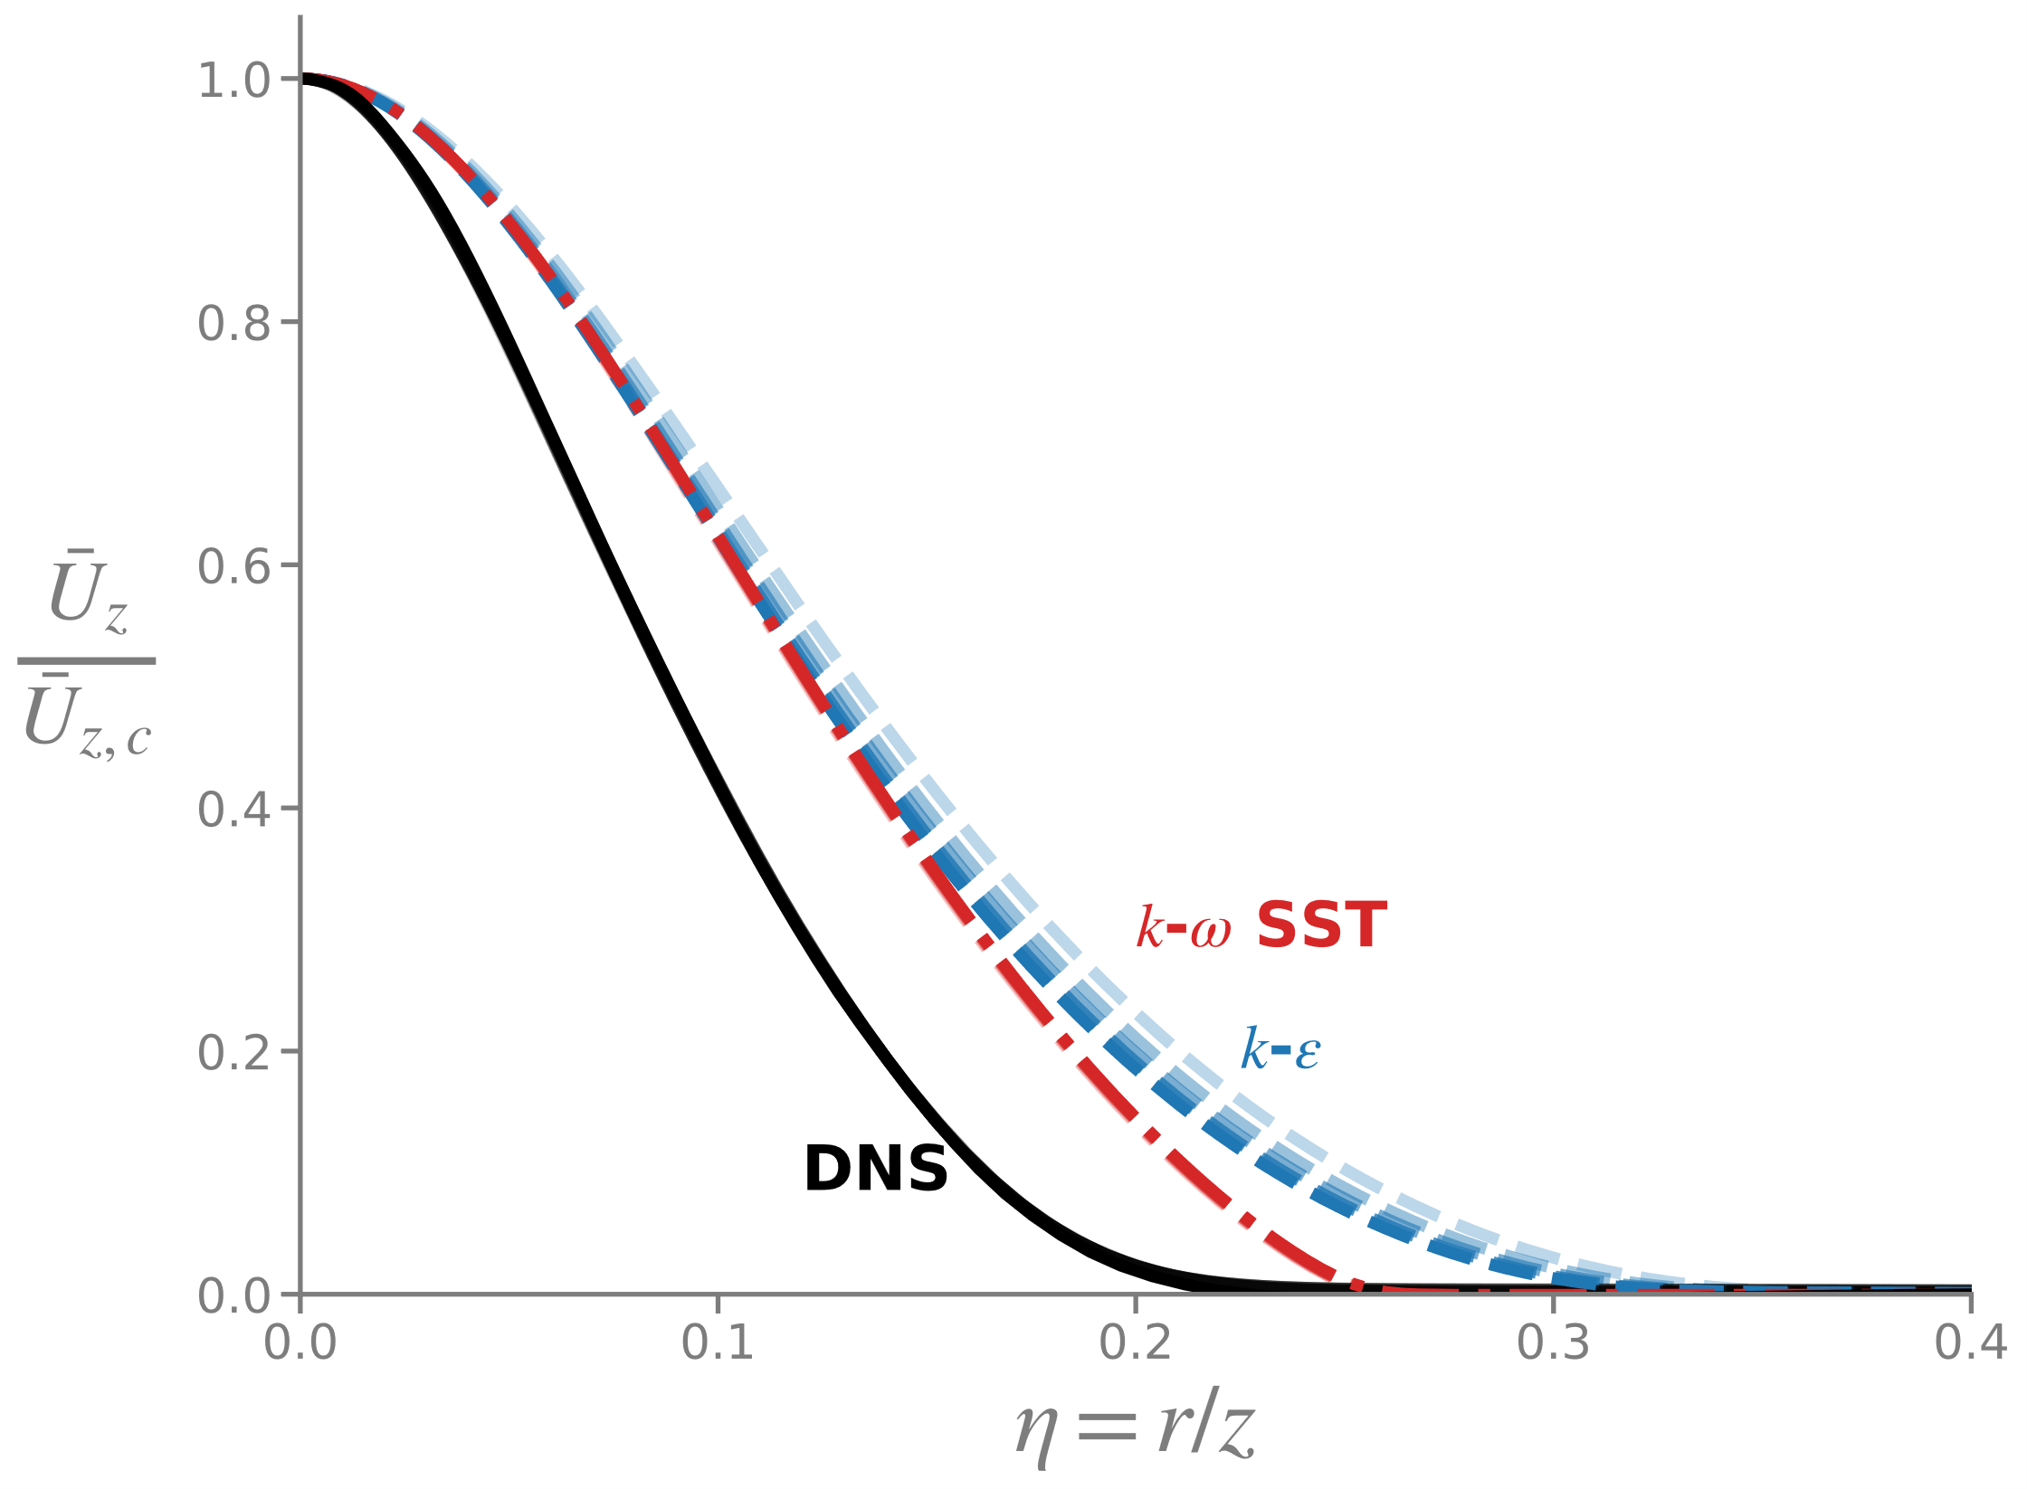
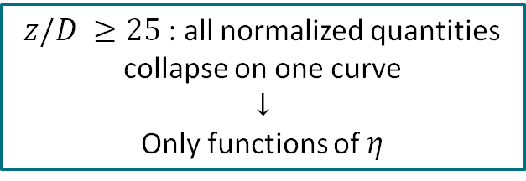
Results : Self-Similarity
$z/D ≥25$: all normalized quantities collapse on one curve
$$↓$$
Only functions of $η$
Self-similarity captured by RANS models
5

Slide 6
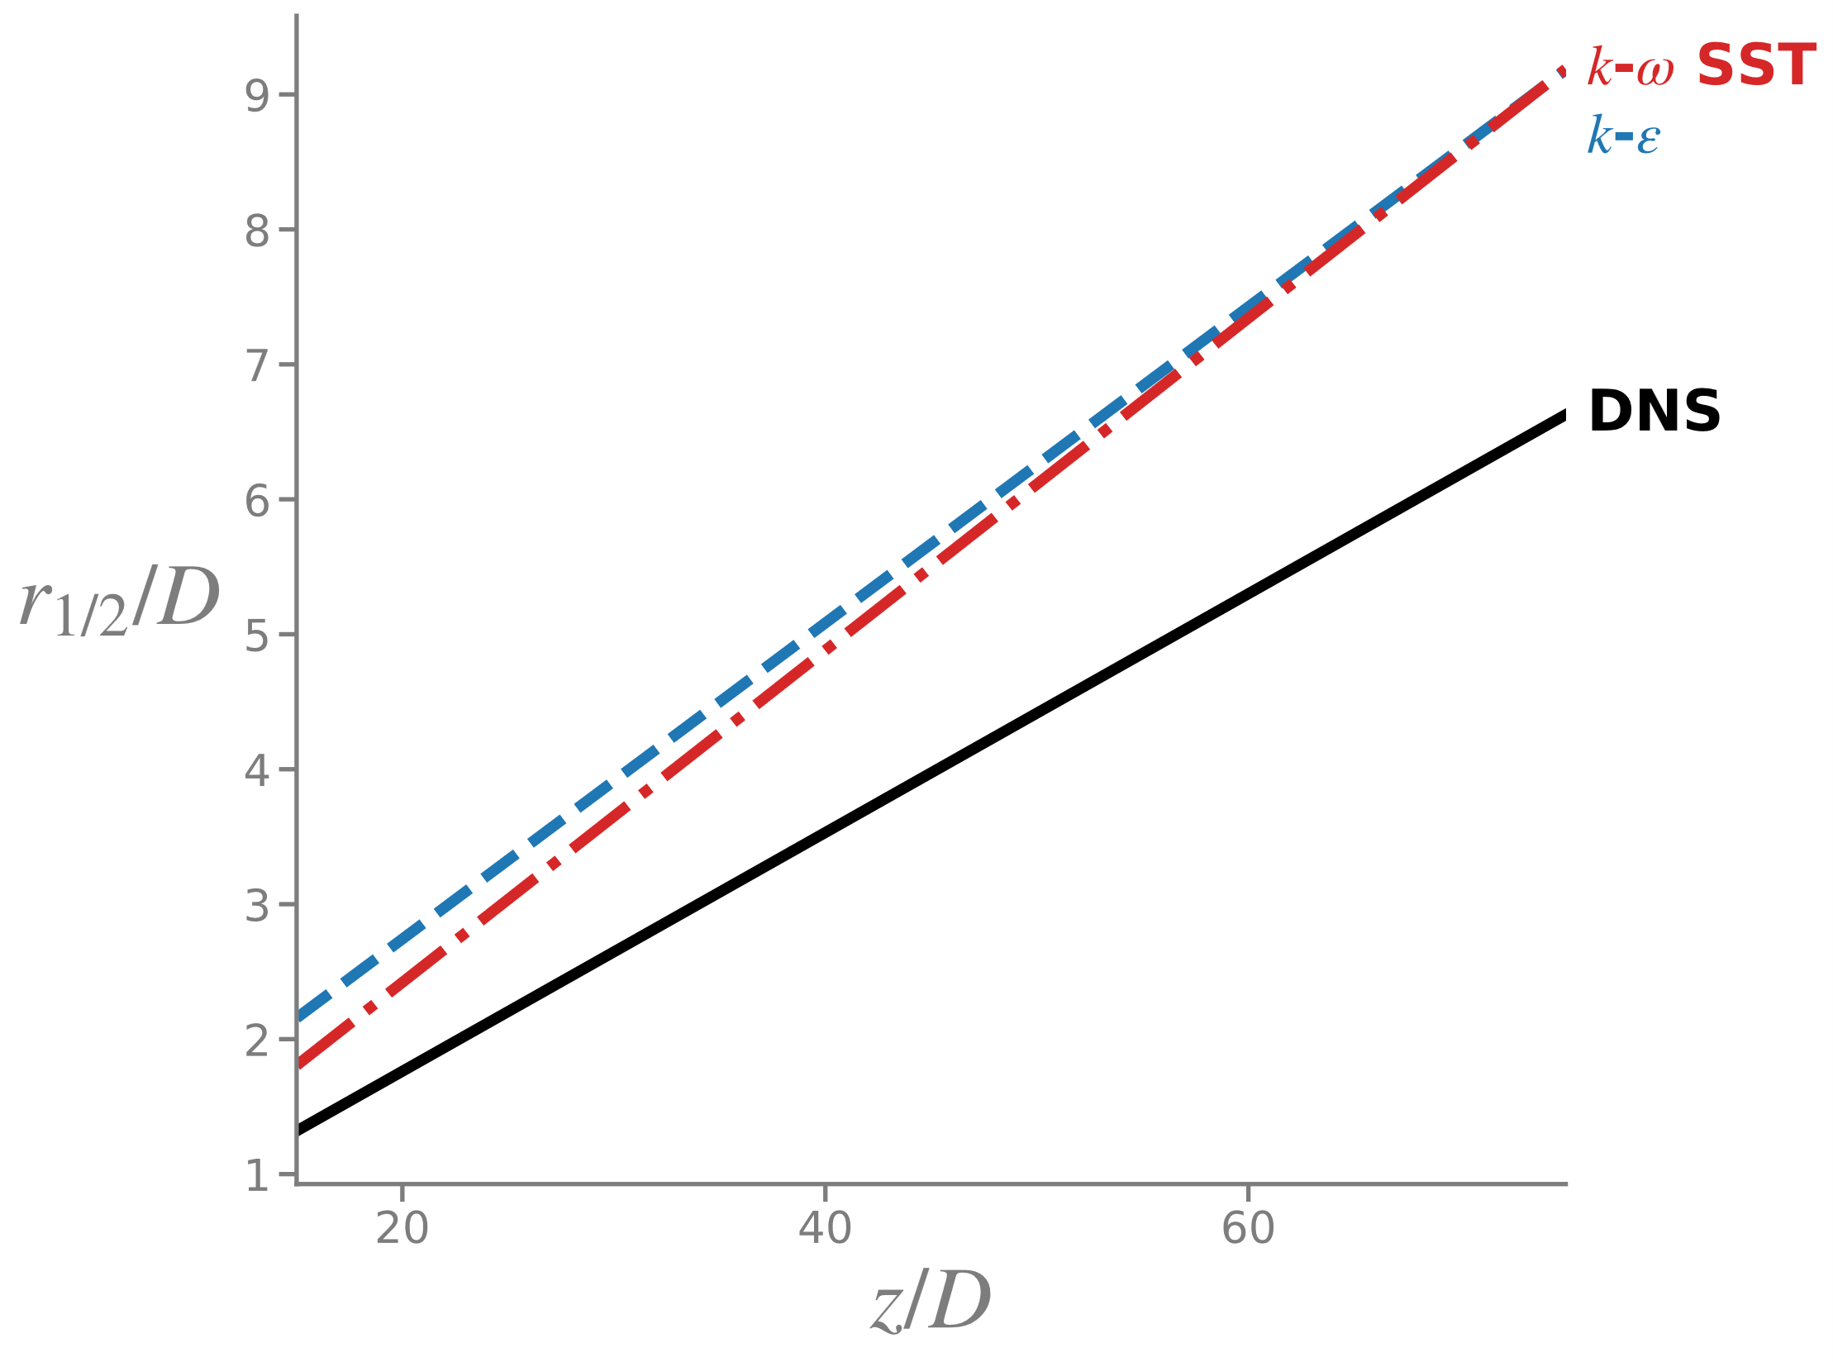
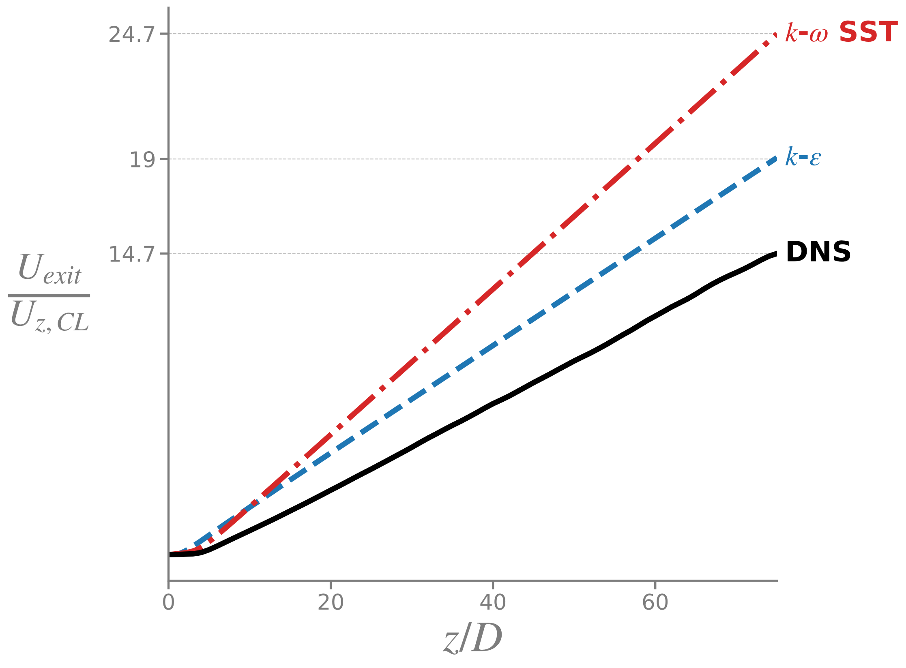
Results : The Round Jet Anomaly
How it fails : Spreading Rate and Velocity Decay
1/3
1/4.1
0.123
1/5
0.117
0.089
Spreading rate overestimated by 30 - 40 %
Decay constant underestimated by 20 - 40 %
6

Slide 7
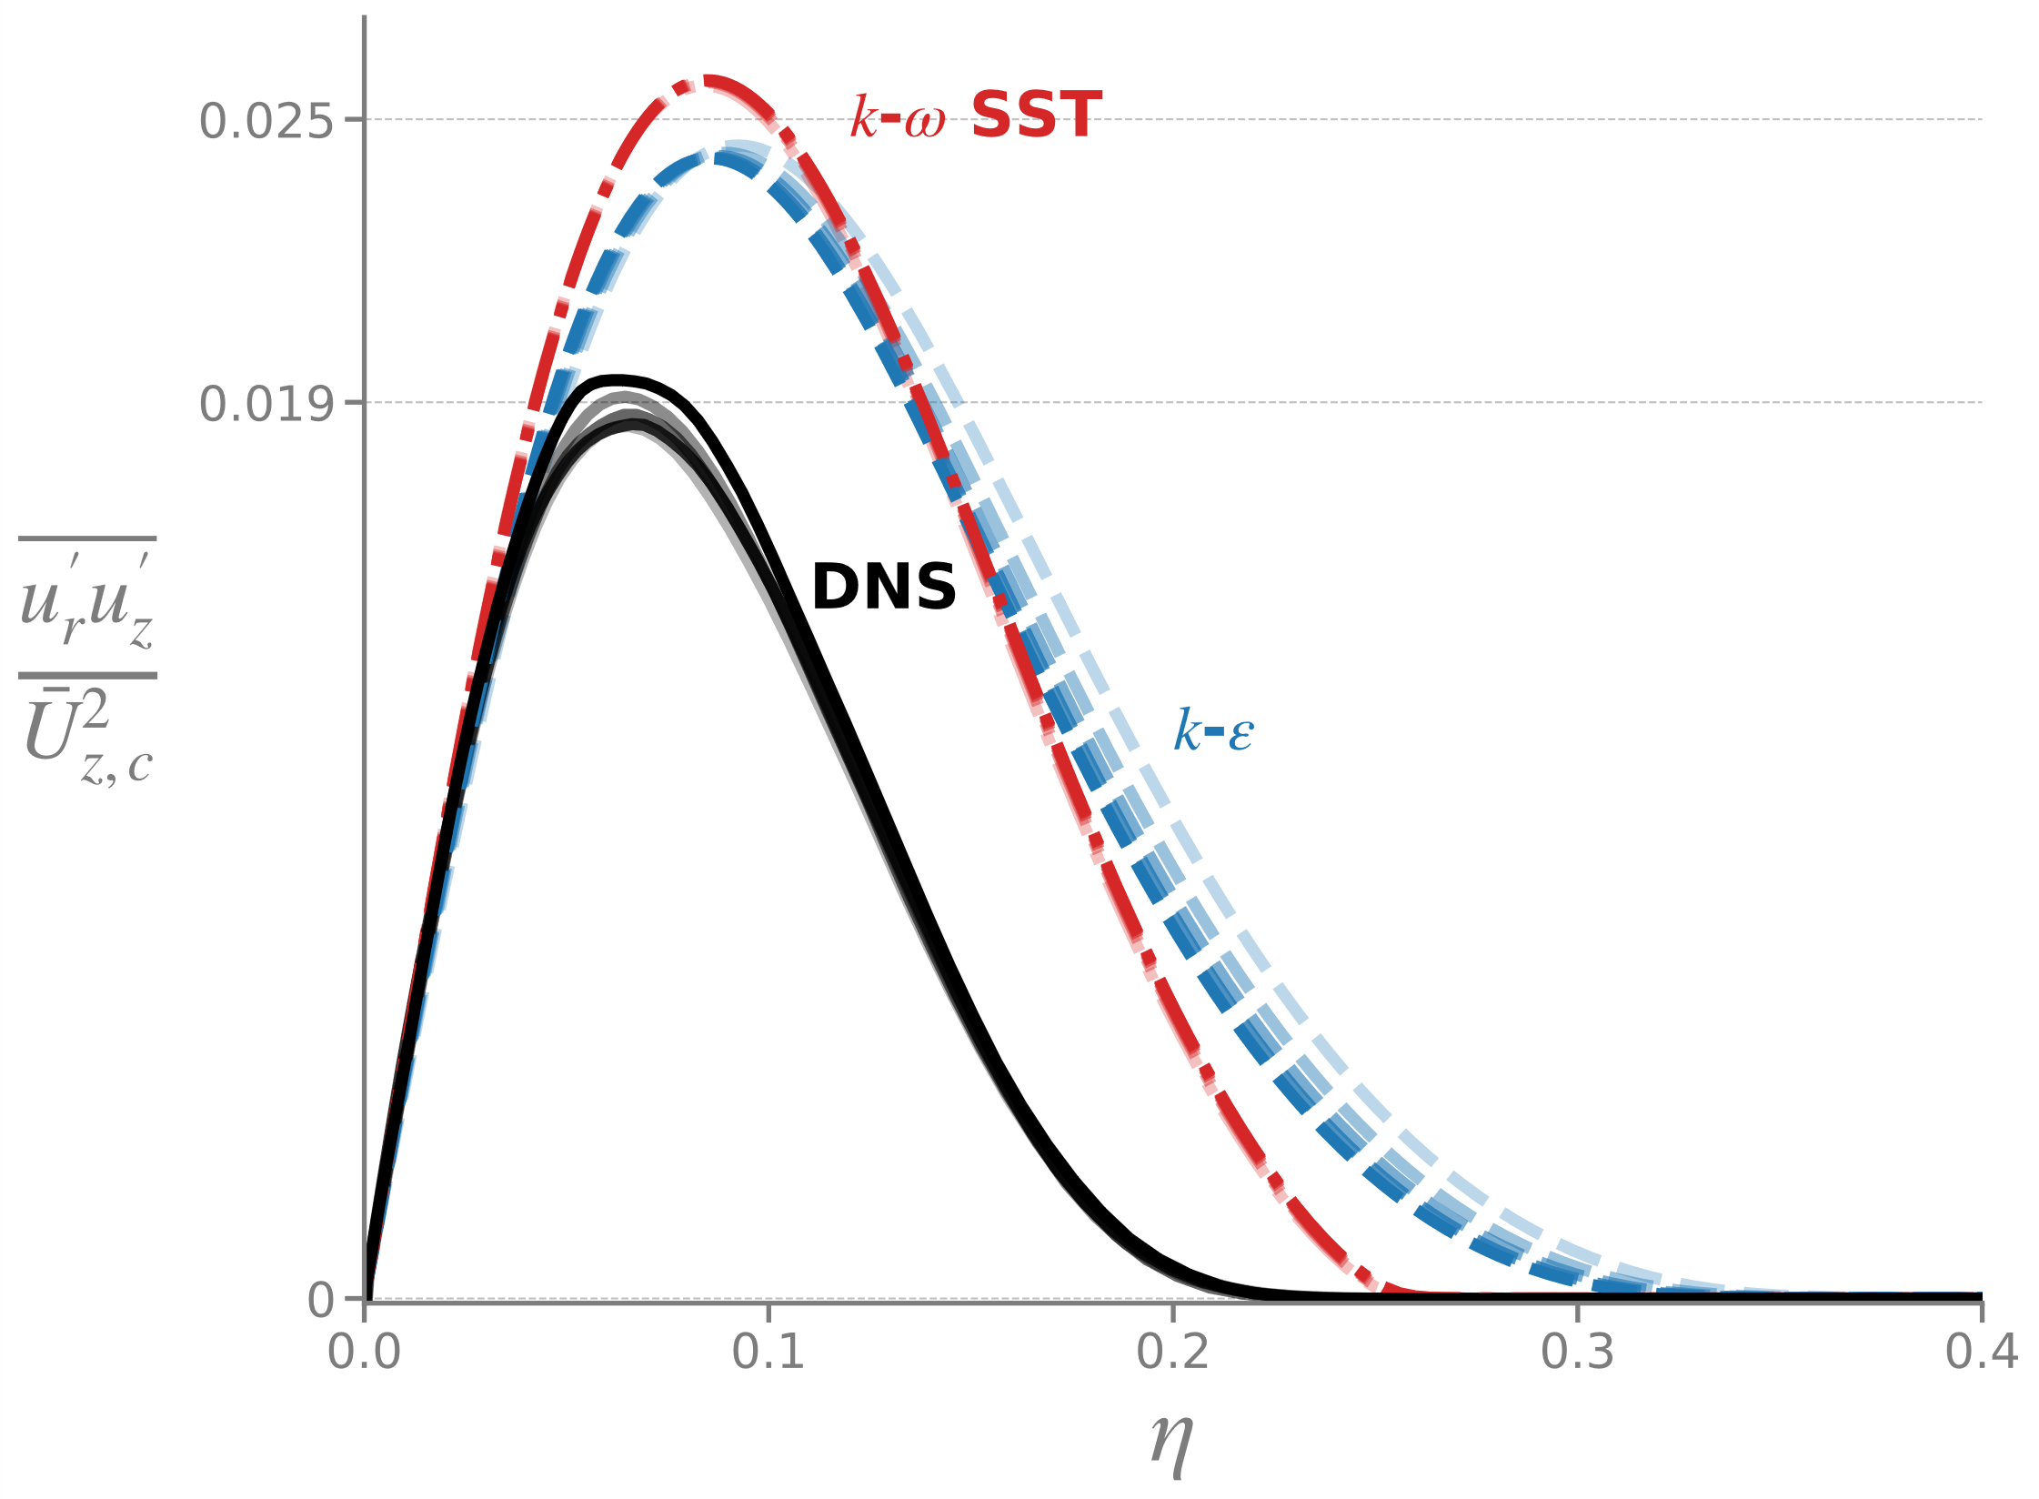

The Mechanism of the Anomaly
Reynolds Shear Stress and Eddy Viscosity
$\overline{u_{r}^{′}u_{z}^{′}}$ overestimated
Reynolds shear stress drives mixing with ambient fluid
Excessive mixing
=
Spreading & velocity decay
7

Slide 8
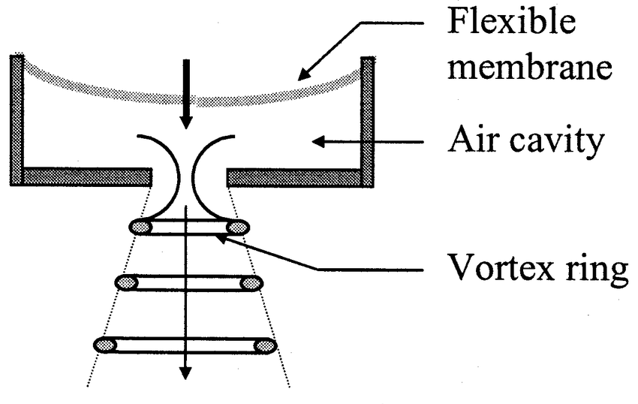
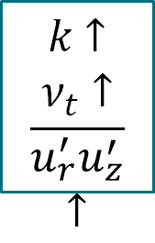


Why it Fails: Vortex Stretching
Dissipation Deficit
Jet Spreading
Vortex Stretching
$$ε↑$$
Standard LEVM
$$ε↓$$
Do not sense stretching
$k$ $↑$
$ν_{t}$ $↑$
$\overline{u_{r}^{′}u_{z}^{′}}$ $↑$
Round Jet Anomaly
Source: Kercher et al., IEEE Trans. Comp. Packag. Technol., 2003
8

Slide 9
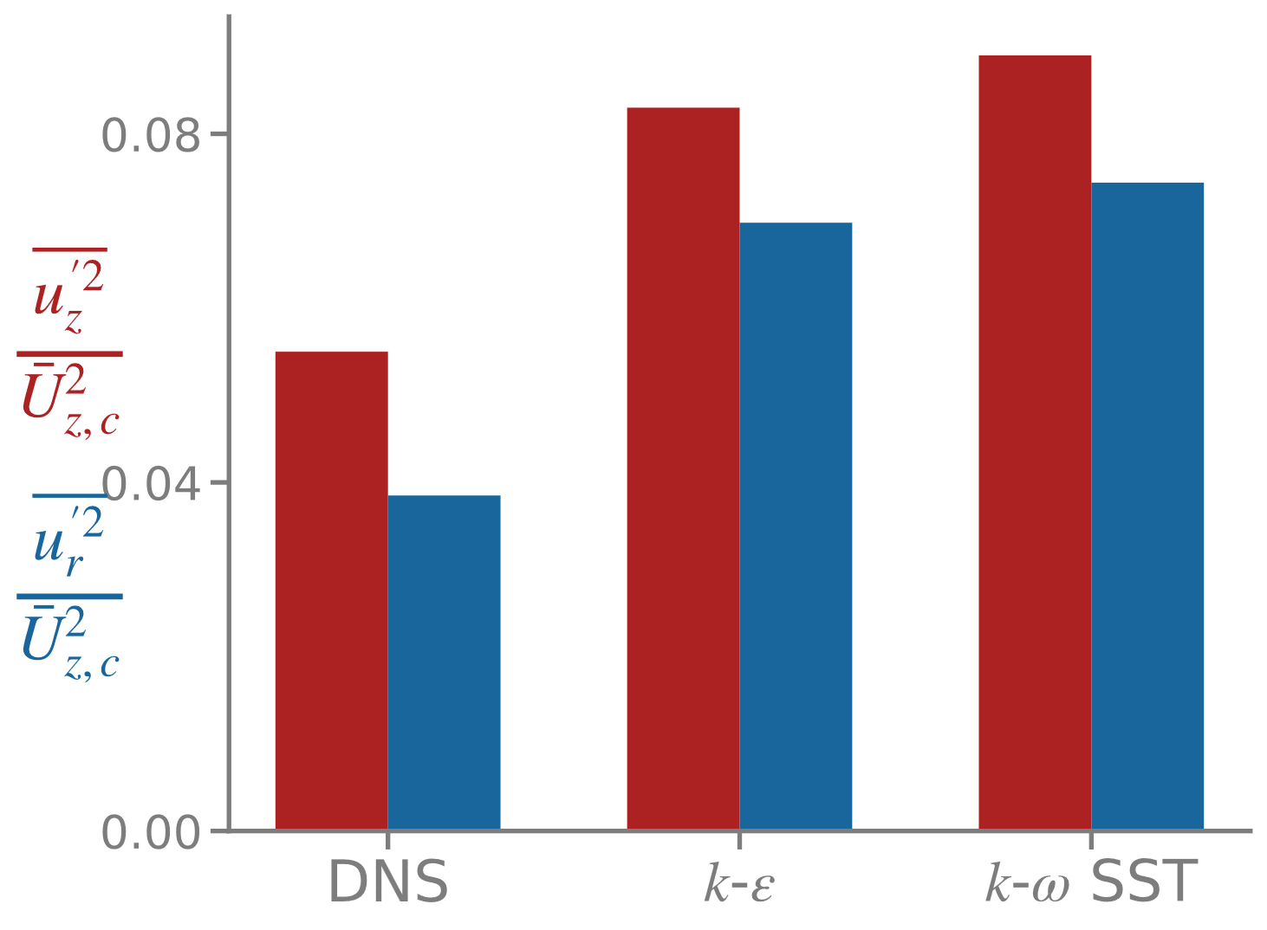
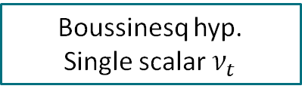
Why it Fails: Turbulence Anisotropy
Limitations of the Boussinesq Hypothesis
Jet turbulence is strongly anisotropic
x1.2
x1.2
Boussinesq hyp.
Single scalar $ν_{t}$
x1.4
Unphysical isotropic turbulence forced
Bad Reynolds stress distribution
9

Slide 10
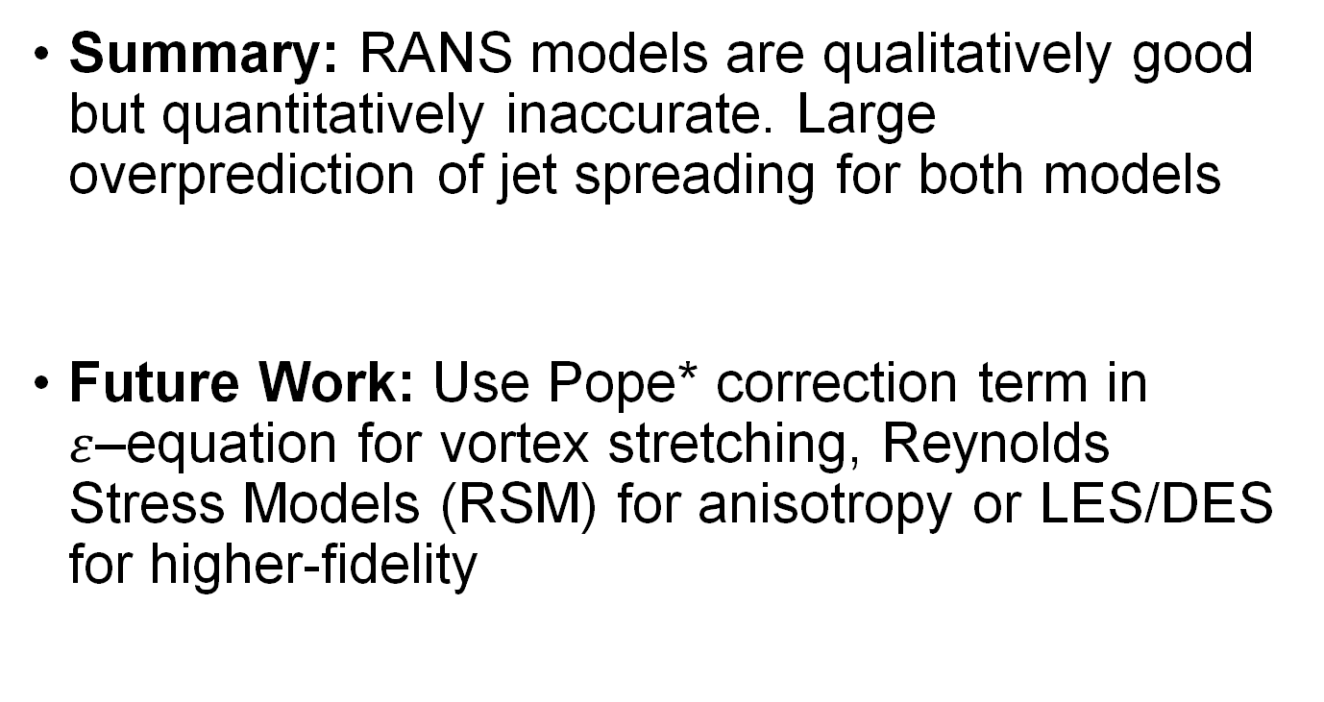
Conclusion
Summary: RANS models are qualitatively good but quantitatively inaccurate. Large overprediction of jet spreading for both models
Future Work: Use Pope* correction term in $ε$–equation for vortex stretching, Reynolds Stress Models (RSM) for anisotropy or LES/DES for higher-fidelity
* An explanation of the turbulent round jet/plane jet anomaly, S. Pope, 1978
10

Slide 11
Thank you for your attention !
11

Slide 12
12

